Slide 1

MySQL and SSD: Usage Patterns
Date, time, place:
MySQL Conference & Expo 2011
12-Apr-2011
Reporter:
Vadim Tkachenko
Co-founder, CTO, Percona Inc

Slide 2
You can get up to 7x gain running MySQL on SSD
  Even 20x with some tricks
Notes:
Percona Server is not only about performance, but we have bunch of features that makes everyday work easier

Slide 3
In this talk
What is best setup of MySQL to get most benefit from SSD / Flash
Notes:
Percona Server is not only about performance, but we have bunch of features that makes everyday work easier

Slide 4
What’s inside
MySQL and SSD: basics
MySQL and SSD: advanced schemas

Slide 5
Types of SSD
SATA
PCI-E
SAN

Slide 6
Types of SSD
SATA
  200-500MB/sec
  Intel X25-M/E, OCZ, Unigen
PCI-E
  Over 1GB/sec, 70.000 req/sec, under 1ms response time
  Virident, FusionIO
SAN
  Violin memory

Slide 7
What is this for MySQL ?
1GB/sec – 70,000 req/sec
  A lot, but MySQL can’t use that all

Slide 8
MySQL basic usage
  Put all data ( ibdata1, ib_log, tables.ibd) on SSD
    5-7x difference

Slide 9
MySQL basic usage
  Boring, some recommendation:
    XFS, better with 4k blocks
      Mkfs.xfs -s size=4096
      Mount –o nobarrier
    Multiple threads
    Percona Server or InnoDB-plugin or MySQL 5.5
  Still uses about 5,000 req/sec, ~200MB/sec

Slide 10
Can we do better ?
  Single threaded sequential stuff
    InnoDB transactional logs with fsyncs
    Binary logs
    Doublewrite buffer ( with whole ibdata)
  RAID with BBU good place for them
    Up to 45% improvement

Slide 11
What is in Percona Server for it ?
  innodb_flush_neighbor_pages= ON | OFF
  innodb_log_block_size = 512 | 4096
  innodb_page_size = 4K | 8K | 16K
    Use carefully
  innodb_doublewrite_file
  Innodb_adaptive_checkpoint=keep_average
  innodb_log_file_size > 4GB

Slide 12
What if ?
  Data is too large
    Or SSD too small

Slide 13
Naive solution
  Most data on regular disks
  Put “hot” ibd files on SSD
    Symlinks from data directory

Slide 14
Naive solution
  It works
  But pain to manage and till first “ALTER TABLE”
  Facebook has patch for it

Slide 15
Advanced solution: caching
  Data stored on regular disks
    Caching data on SSD
  Flashcache
    Open source
    Developed and maintained by Facebook, deployed in production
  DirectCache
    Proprietary solution from FusionIO

Slide 16
FlashCache
  Shows good results
  Stable work in production deployments
  Not much user friendly

Slide 17
FlashCache details
  Write-through and write-back modes
  FIFO and LRU block management
  You need to compile kernel module by yourself
  The same choice for ibdata1/ib_logs location

Slide 18
ZFS
  ZFS supports SSD caching mode
  Linux native port available

Slide 19
Interesting trick
  For temporary tables on disks
  --tmpdir=/mnt/ssd

Slide 20
Still not enough space?
  Several SSD / Flash cards in the server

Slide 21
Combining cards
  SATA
    Choice good RAID controller, maybe challenge
  PCI-E
    Software RAID
      Usually comes as stripping ( RAID0 )
      Reliability ?
      Mirroring does not work really well

Slide 22
What about promised 20x ?
Single MySQL instance is not able to utilize all IO provided by card

Slide 23
Several instances
Solution obvious:
  Several instances

Slide 24
Experiment
Dell PowerEdge R815
4 physical AMD CPUs / 48 cores
144GB of RAM
Virident tachIOn 200GB card
48 user connections

Slide 25
Experiment
Dell PowerEdge R815
4 physical AMD CPUs / 48 cores
144GB of RAM
Virident tachIOn 200GB card
Tpcc-mysql workload
  48 user connections

Slide 26
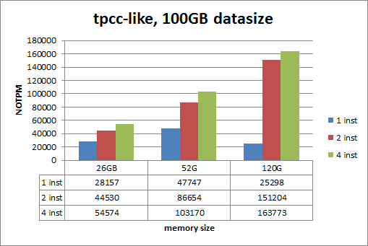
Results

Slide 27
Results conclusions
With 120GB memory single instance result worse then with 26GB
  InnoDB contentions problems again
Two instances allows to improve 1.5x-6x

Slide 28
Multi-instance
I do not like it
  Management complexity
  Good scripts solve it
2 instances seems reasonable
SAN-like Flash-arrays

Slide 29
The end
Slides will be online. http://www.percona.com/about-us/presentations/
vadim@percona.com
Your questions ?
We are hiring!
Notes:
If you are familiar with cache concepts, there two popular ways to handle writes, and FlashCache supports both of them: Write Through and Write Back.

